Slide 1
Gene Sequence Analysis
Lecture 1: Homology Searching
23/05/2024
Phuc-Loi Luu, PhD
Adapted from Dr. Morgan Langille and Dr. G P S Raghava

Slide 2
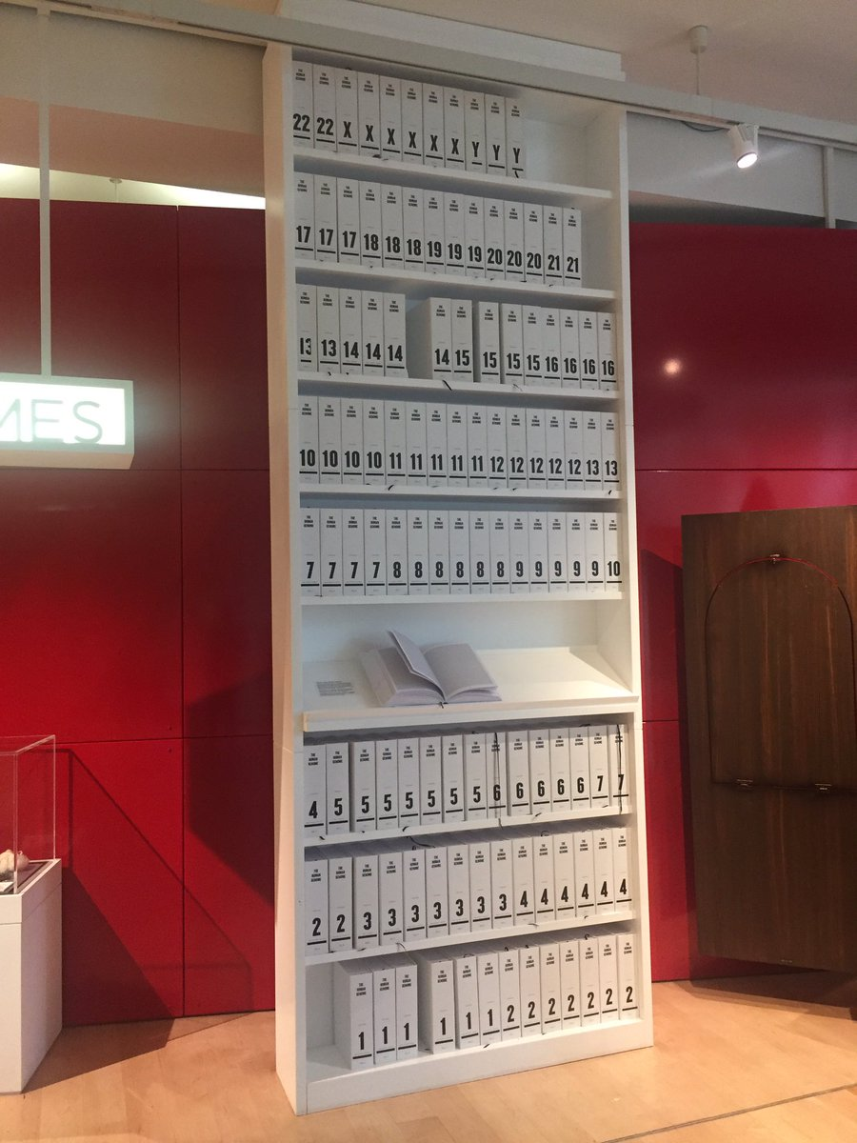

Slide 3
Outline
What is homology, orthologs, paralogs?
Local vs global alignment
E-values, bit scores, "coverage", identity vs similarity
Different blast flavours (blastn, blastp, tblastn, etc.)
Blast (Web)

Slide 4
What is homology?
●
Homology refers to shared ancestry
●
Two sequences are homologous if they are derived from a common ancestral sequence
●
One sequence by itself is not informative
●
it must be analyzed by comparative methods against existing sequence databases to develop hypothesis concerning relatives and function.

Slide 5
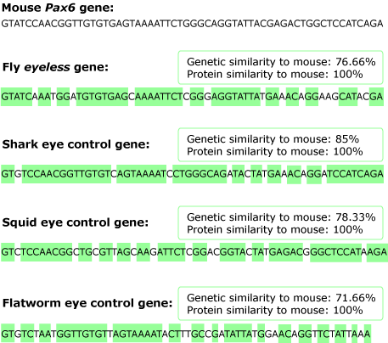
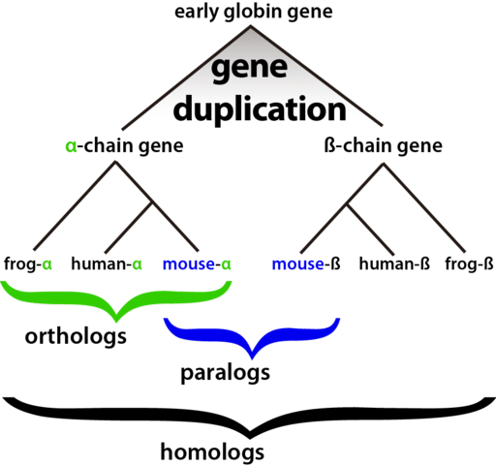
What is homology?
https://evolution.berkeley.edu/evolibrary/article/1_0_0/eyes_10
Photo courtesy of: Popo H. Liao (Own work), via Wikimedia Commons

Slide 6
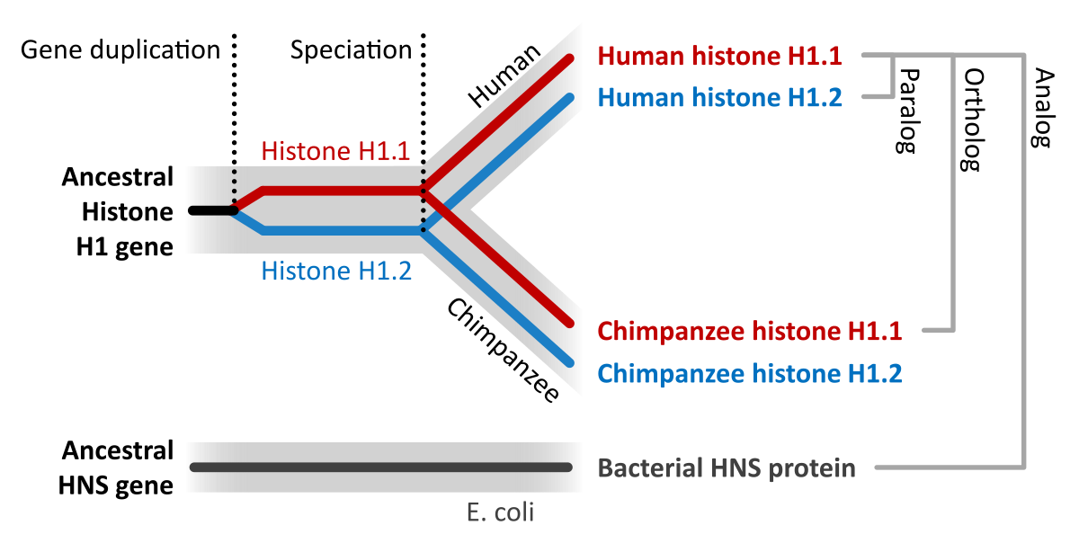
Types of homologs
●
Orthologs
Think same gene in different organism Often thought to have similar function
●
●
●
Paralogs
Think gene duplication
Less likely to have similar function
●
●
https://en.wikipedia.org/wiki/Sequence_homology

Slide 7
What is similarity?
●
Similarity is a measure of the likeness between sequences.
●
Gene searching tools calculate the similarity between sequences and rank more similar sequences higher.
●
Sequences can NOT be partially homologous
●
WRONG: Gene X is 80% homologous to Gene Y
●
Sequences can be partially similar
●
CORRECT: Gene X has 80% identity to Gene Y

Slide 8
Identity vs Similarity
●
Identity is a percentage measurement that states how many characters in the sequence are identical
●
Similarity can also be used as a metric which means how many characters are “positive scoring”

Slide 9
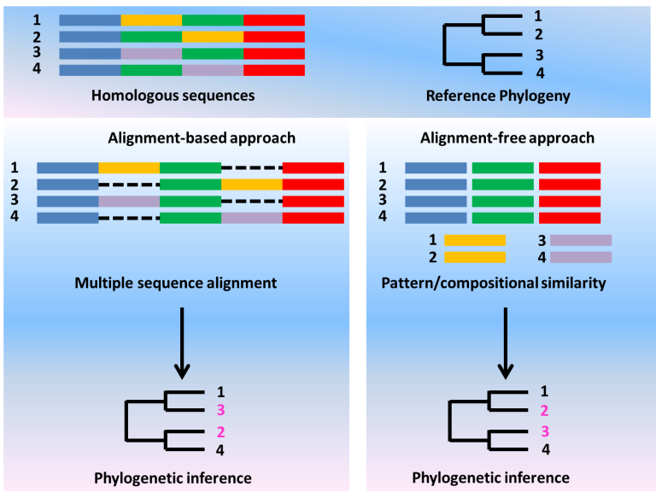
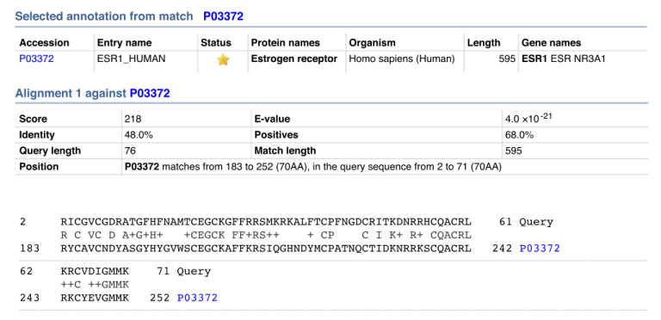
Identity vs Similarity
Similarity in sequence alignment is the resemblance between two sequences when compared. This fact is dependent on the identity of sequences. Similarity depicts the extent to which the residues are aligned. Hence, similar sequences contain similar properties. In bioinformatics, similarity is a tool to assess the likeness between two proteins.
Identity in sequence alignment is the number of characters that match exactly between two different sequences. Hence, gaps do not count when assessing identity. The measurement is considered to be relational to the shorter sequence among the two sequences. It significantly implies that it has the effect where the sequence identity is not transitive. If X=Y and Y=Z, then X is not necessarily equal to Z. This is deduced in terms of the identity distance measure.
X = AAGGCTT, Y = AAGGC and Z = AAGGCAT.
Identity between X and Y is 100% {5 identical nucleotides / min[length(X),length(Y)]}.
Identity between Y and Z is also 100%.
But identity between X and Z is only 85% {(6 identical nucleotides / 7)}.
https://www.differencebetween.com/difference-between-similarity-and-identity-in-sequence-alignment

Slide 10
Identity vs Similarity
Identity
The extent to which two (nucleotide or amino acid) sequences are invariant (identical).
Similarity
The extent to which (nucleotide or amino acid) sequences are related. The extent of similarity between two sequences can be based on percent sequence identity and/or conservation. In BLAST similarity refers to a positive matrix score. This is quite flexible (see later examples of DNA polymerases) – similar across the whole sequence or similarity restricted to domains !
Homology
Similarity attributed to descent from a common ancestor.

Slide 11
Assessing Sequence Similarity
Rbn Lsz
KETAAAKFERQHMD KVFGRCELAAAMKRHGLDNYRGYSLGNWVCAAKFESNFNT
SST SAASSSNYCNQMMKSRNLTKDRCKPMNTFVHESLA QATNRNTDGSTDYGILQINSRWWCNDGRTP GSRN
Rbn Lsz
Rbn Lsz
DVQAVCSQKNVACKNGQTNCYQSYSTMSITDCRETGSSKY LCNIPCSALLSSDITASVNC AKKIVSDGDGMNAWVAWR
PNACYKTTQANKHIIVACEGNPYVPHFDASV NRCKGTDVQA WIRGCRL
is this alignment significant?
Rbn Lsz

Slide 12
DNA scoring systems
Sequence 1 ACTACCAGTTCATTTGATACTTCTCAAA
| | | ||
Sequence 2 TACCATTACCGTGTTAACTGAAAGGACTTAAAGACT
A C G T
A 1 0 0 0
C 0 1 0 0
G 0 0 1 0
T 0 0 0 1
Match: 5 x 1 = 5
Mismatch: 19 x 0 = 0
Score: 5

Slide 13
The Scoring Schemes or Weight Matrices
Genetic Code Scoring
Fitch 1966 based on Nucleotide Base change required (0,1,2,3)
Required to interconvert the codons for the two amino acids
Rarely used nowadays

Slide 14
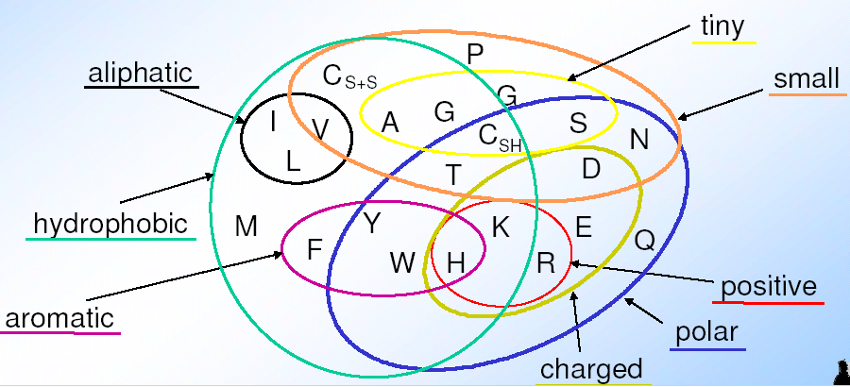
Complication: „inexact“ is not binary (1|0) but something relative
Amino acids have different physical and biochemical properties that are/are not important for function and thus influence their probability to be replaced in evolution

Slide 15
The Scoring Schemes or Weight Matrices
Chemical Similarity Scoring
Similarity based on Physio-chemical properties
MacLachlan 1972, Based on size, shape, charge and polar
Score 0 for opposite (e.g. E & F) and 6 for identical character

Slide 16
The Scoring Schemes or Weight Matrices
Observed Substitutions or PAM matrices
Based on Observed Substitutions
Chicken and Egg problem
Dayhoff group in 1977 align sequence manually
Observed Substitutions or point mutation frequency
MATRICES are PAM30, PAM250, PAM100 etc
AILDCTGRTG……
ALLDCTGR--……
SLIDCSAR-G……
AILNCTL-RG……

Slide 17
Twilight Zone
Evolutionary Distance VS Percent Sequence Identity
120
100
80
60
40
20
0
Sequence Identity (%)
Twilight Zone
0 40 80 120 160 200 240 280 320 360 400
Number of Residues

Slide 18
Some Simple Suggestions
●
If two sequence are > 100 residues and > 25% identical, they are likely related
●
If two sequences are 15-25% identical they may be related, but more tests are needed
●
If two sequences are < 15% identical they are probably not related

Slide 19
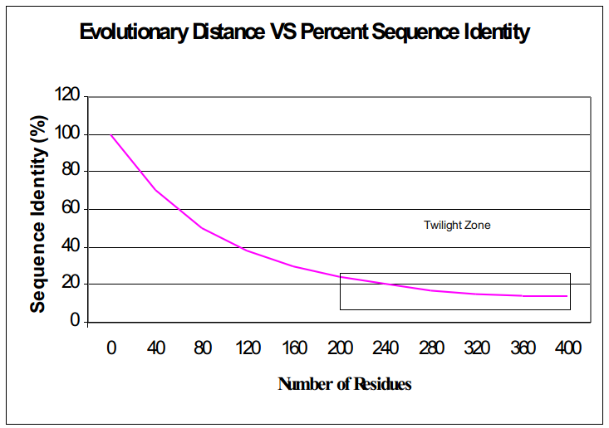
Importance of Similarity
Rule-of-thumb:
If your sequences are more than 100 amino acids long (or 100 nucleotides long) you can considered them as homologues if 25% of the aa are identical (70% of nucleotide for DNA). Below this value you enter the twilight zone.
Twilight zone = protein sequence similarity between ~0-20% identity: is not statistically significant, i.e. could have arisen by chance.

Slide 20
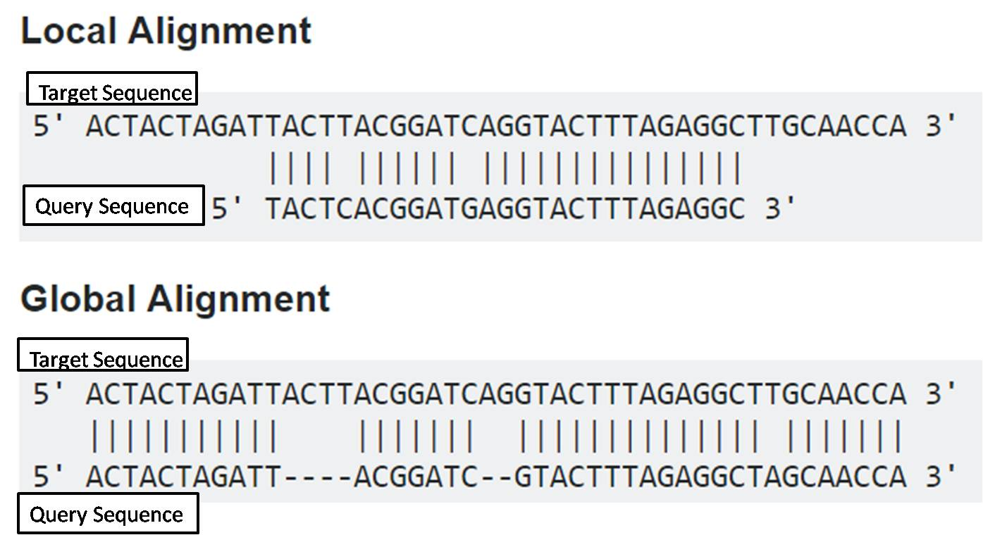
Global vs Local
●
Alignments can be global or local (this is algorithm specific)
●
A global alignment is an optimal alignment that includes all characters from each sequence (Multiple Sequence Alignment)
A local alignment is an optimal alignment that includes only the most similar local region or regions (e.g BLAST).
●
https://www.majordifferences.com/2016/05/difference-between-global-and-local.html

Slide 21
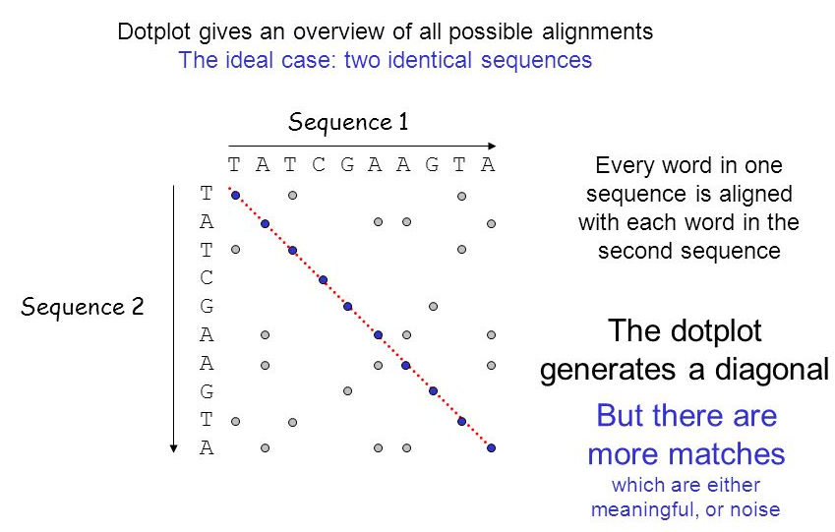
Dot Plots
●
Popular freeware package is Dotter
http://sonnhammer.sbc.su.se/Dotter.html
11

Slide 22
Dotplot
Dotplot gives an overview of all possible alignments
The ideal case: two identical sequences
Sequence 1
T A T C G A A G T A
T
A
T
C
G
A
A
G
T
A
Every word in one sequence is aligned with each word in the second sequence
Sequence 2
The dotplot generates a diagonal
But there are more matches
which are either meaningful, or noise

Slide 23
Dotplot
Dotplot gives an overview of all possible alignments
The normal case: two somewhat similar sequences
Sequence 1
T A T C G A A G T A
T
A
T
T
C
A
T
G
T
A
isolated dots
Sequence 2
2 dots form a diagonal
3 dots form a diagonal

Slide 24
Dotplot
Dotplot gives an overview of all possible alignments
Sequence 1
T A T C G A A G T A
T
A
T
T
C
A
T
G
T
A
Sequence 2
Word Size = 1

Slide 25
Dotplot
In a dotplot each diagonal corresponds to a possible (ungapped) alignment
Sequence 1
T A T C G A A G T A
T
A
T
T
C
A
T
G
T
A
One possible alignment
Sequence 2
TATCGAAGTA
|| |
TATTCATGTA
Word Size = 1

Slide 26
Dotplot
Dotplot gives an overview of all possible alignments
Filters (word size) can be introduced to get rid of noise
Sequence 1
Word size = 1
T A T C G A A G T A
T
A
T
T
C
A
T
G
T
A
isolated dots
Sequence 2
2 dots form a diagonal
3 dots form a diagonal

Slide 27
Dotplot
Dotplot gives an overview of all possible alignments
Filters (word size) can be introduced to get rid of noise
Sequence 1
Word size = 2
T A T C G A A G T A
T
A
T
T
C
A
T
G
T
A
Sequence 2
2 dots form a diagonal
3 dots form a diagonal

Slide 28
Dotplot
Dotplot gives an overview of all possible alignments
Filters (word size) can be introduced to get rid of noise
Sequence 1
Word size = 3
T A T C G A A G T A
T
A
T
T
C
A
T
G
T
A
Sequence 2
3 dots form a diagonal

Slide 29
Dotplot
Dotplot gives an overview of all possible alignments
Filters (word size) can be introduced to get rid of noise
Sequence 1
Word size = 4
T A T C G A A G T A
T
A
T
T
C
A
T
G
T
A
Sequence 2
conditions too stringent !!

Slide 30
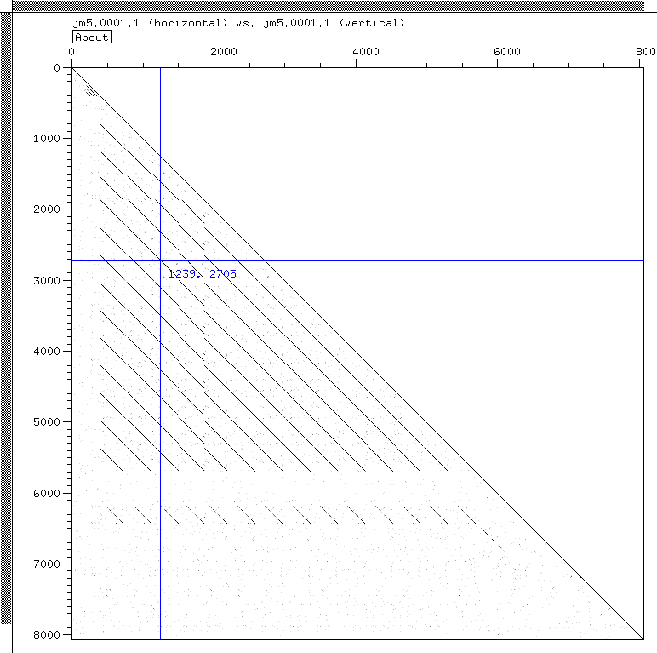
Dot matrix: example of a repetitive DNA sequence
In addition to the main diagonal, there are several other diagonal.
Only one half of the matrix is shown because of the symmetry.
perfect tool to visualize repeats

Slide 31
Problems with Dot matrices
Rely on visual analysis (necessarily merely a screen dump due to number of operations) Improvement: Dotter (Sonnhammer et al.)
Difficult to find optimal alignments
Difficult to estimate significance of alignments
Insensitive to conserved substitutions (e.g. L ↔ I or S ↔T) if no substitution matrix can be applied
Compares only two sequences (vs. multiple alignment)
Time consuming (1,000 bp vs. 1,000 bp = 10⁶ operations, 1,000,000 vs. 1,000,000 bp = 10¹² operations)

Slide 32
The BLAST algorithm
●
The BLAST programs (Basic Local Alignment Search Tools) are a set of sequence comparison algorithms introduced in 1990 that are used to search sequence databases for optimal local alignments to a query.
●
Altschul SF, Gish W, Miller W, Myers EW, Lipman DJ (1990) “Basic local alignment search tool.” J. Mol. Biol. 215:403-410.
●
Altschul SF, Madden TL, Schaeffer AA, Zhang J, Zhang Z, Miller W, Lipman DJ (1997) “Gapped BLAST and PSI-BLAST: a new generation of protein database search programs.” NAR 25:3389-3402.
12

Slide 33
Several different BLAST programs
Program
Description
blastp
Compares an amino acid query sequence against a protein sequence database.
blastn
Compares a nucleotide query sequence against a nucleotide sequence database.
blastx
Compares a nucleotide query sequence translated in all reading frames against a protein sequence database. You could use this option to find potential translation products of an unknown nucleotide sequence.
tblastn
Compares a protein query sequence against a nucleotide sequence database dynamically translated in all reading frames.
tblastx
Compares the six-frame translations of a nucleotide query sequence against the six-frame translations of a nucleotide sequence database. Please note that the tblastx program cannot be used with the nr database on the BLAST Web page because it is too computationally intensive.
13

Slide 34
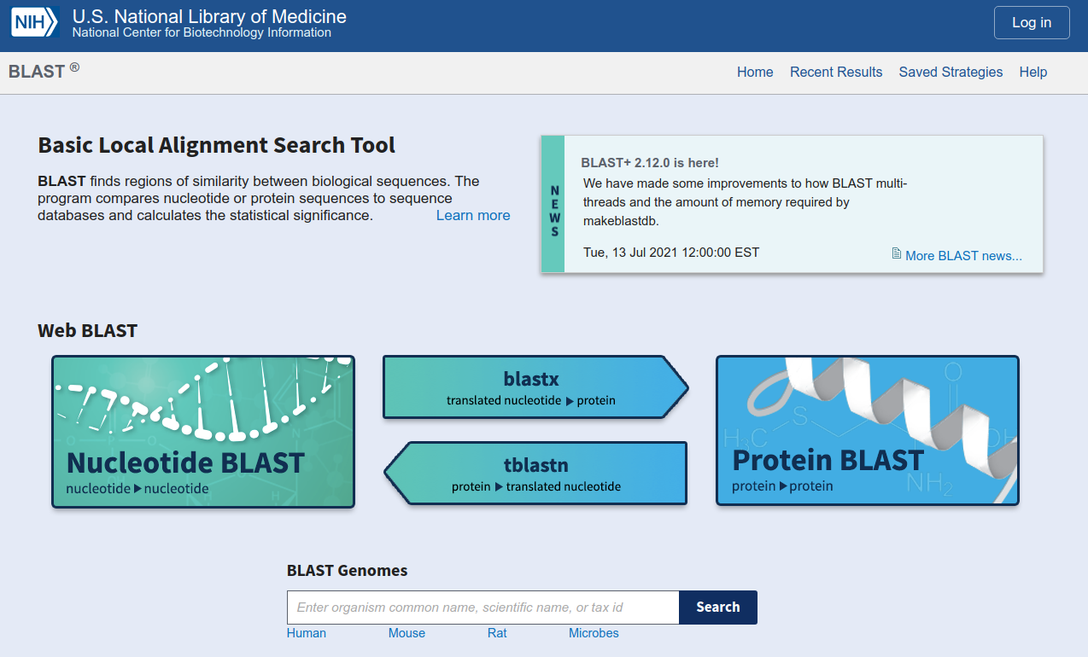
https://blast.ncbi.nlm.nih.gov/Blast.cgi

Slide 35
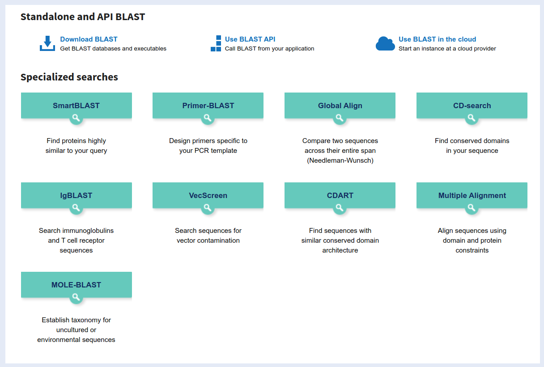

Slide 36
MegaBLAST
●
megaBLAST
For aligning very similar sequences Nucleotide only
Very efficient for long query sequences Uses big word (k-tuple) sizes to start search
– Very fast
●
●
●
●

Slide 37
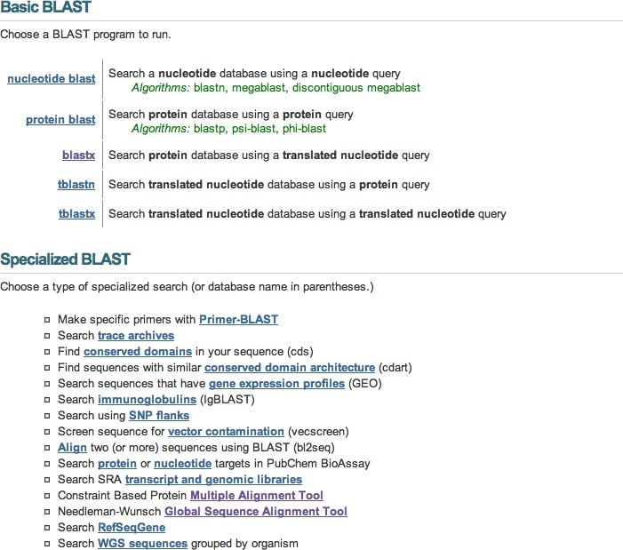
http://www.ncbi.nlm.nih.gov/BLAST/

Slide 38
http://www.ncbi.nlm.nih.gov/BLAST/

Slide 39
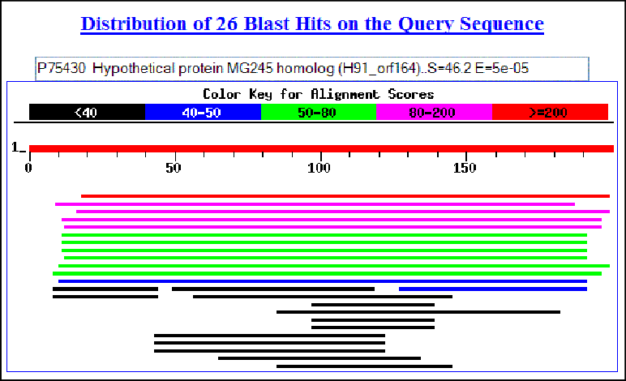
QUERY sequence(s)
BLAST results
BLAST program
BLAST
database

Slide 40
Considerations for choosing a BLAST database
●
First consider your research question:
●
Are you looking for an particular gene in a particular species?
– BLAST against the genome of that species.
Are you looking for additional members of a protein family across all species?
●
BLAST against the non-redudant database (nr), if you can’t find hits check wgs, htgs, and the trace archives.
Are you looking to annotate genes in your species of interest?
–
●
– BLAST against known genes (RefSeq) and/or ESTs from a closely related species.

Slide 41
When choosing a database for
BLAST…
●
Changing your choice of database is changing your search space
●
Database size affects the BLAST statistics
●
Databases change rapidly and are updated frequently

Slide 42
Where does the score (S) come from?
●
The quality of each pair-wise alignment is represented as a score and the scores are ranked.
Scoring matrices are used to calculate the score of the alignment base by base (DNA) or amino acid by amino acid (protein).
The alignment score will be the sum of the scores for each position.
●
●

Slide 43
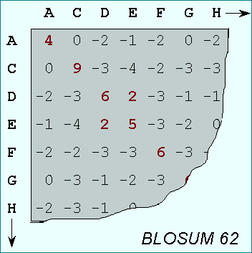
What’s a scoring matrix?
●
Substitution matrices are used for amino acid alignments.
each possible residue substitution is given a score
A simpler unitary matrix is used for DNA pairs
●
●
●
each position can be given a score of +1 if it matches and a score of
-1 if it does not.

Slide 44
BLOSUM vs. PAM
BLOSUM 45
PAM 250
More Divergent
BLOSUM 62
PAM 160
BLOSUM 90
PAM 100
Less Divergent
•
BLOSUM 62 is the default matrix in BLAST. Though it is tailored for comparisons of moderately distant proteins, it performs well in detecting closer relationships. A search for distant relatives may be more sensitive with a different matrix.

Slide 45
Sequence Similarity Searching – The statistics are important
Discriminating between real and artifactual matches is done using an estimate of probability that the match might occur by chance.
●

Slide 46
What do the Score and the e-value really
mean?
●
The quality of the alignment is represented by the Score.
●
Score (S)
The score of an alignment is calculated as the sum of substitution and gap scores. Substitution scores are given by a look-up table (PAM, BLOSUM) whereas gap scores are assigned empirically .
The significance of each alignment is computed as an E value.
–
●
●
E value (E)
–
Expectation value. The number of different alignments with scores equivalent to or better than S that are expected to occur in a database search by chance. The lower the E value, the more significant the score.

Slide 47
I’m confused! What does the E-value mean
again?
●
E value (E)
Expectation value. The number of different alignments with scores equivalent to or better than S that are expected to occur in a database search by chance. The lower the E value, the more significant the score.
When E < 0.01, P-values and E-value are nearly identical.
●
●
●
So, the E-value is the number of times you expect to see your hit occur in the database (with as good as or better score) due to random chance alone.

Slide 48
Notes on E-values
●
Low E-values suggest that sequences are homologous
●
Can’t show non-homology
●
Statistical significance depends on both the size of the alignments and the size of the sequence database
●
Important consideration for comparing results across different searches
E-value increases as database gets bigger E-value decreases as alignments get longer
●
●

Slide 49
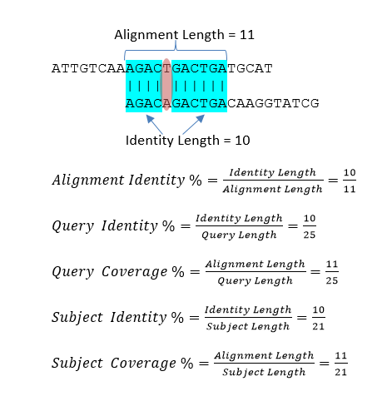
Coverage
●
Coverage: The proportion of the aligned length with respect to the length of the query or subject.
Example
●
●
Your gene is 1000bp, and you have a Blast alignment from 250-500. What is the query coverage?
https://www.stn.org/help/stnext/Managing_Your_STNext_Files/Biosequences/Biosequence_Results/BLAST/Filter_Results_-_BLAST.htm

Slide 50
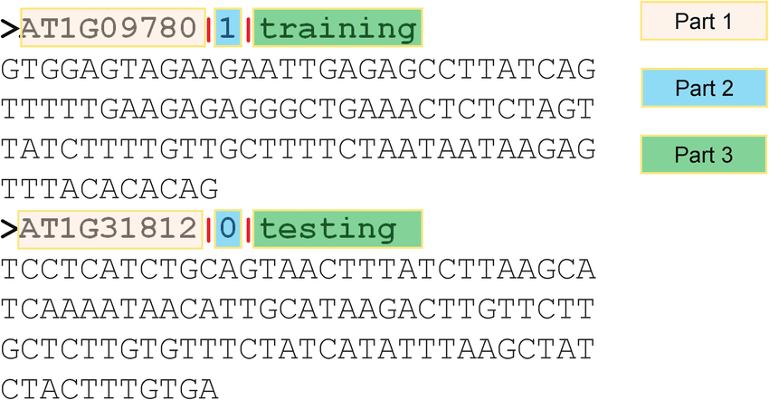
FASTA File Format
Plain text file (e.g. don't open with Word!) Each sequence has 2 parts.
●
●
One header line starts with “>”
e.g. “>This is a fasta header. Any text goes here.”
One or more sequence lines:
e.g. “ATTCTCGCTCGAATCGATCGCATAGTAGCA”
●
●
Each file can contain multiple sequences
Sequences can be DNA or protein (not a mixture)
●
●
28

Slide 51
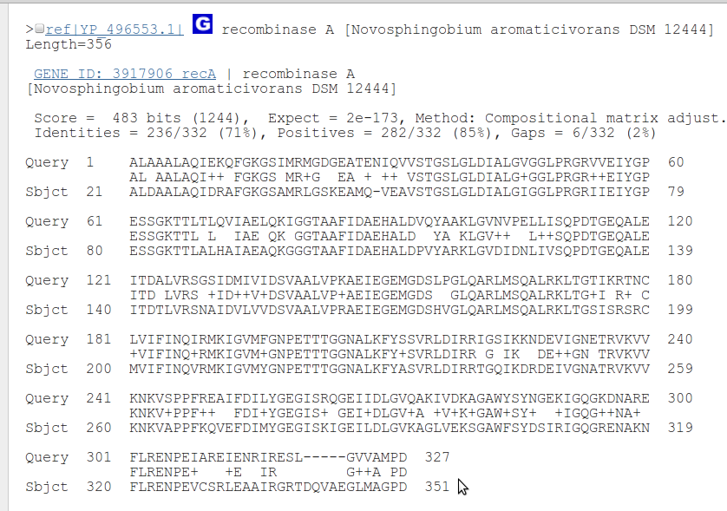
Alignments

Slide 52
Databases
●
NR “non-redundant” database
Sequences from various experiments (not just completed genomes) May not be that “non-redundant”
●
●
●
RefSeq
Curated sequences by NCBI Does not contain duplicates
●
●
●
Swissprot
●
A manually curated sequence of proteins
●
Protein Data Bank
●
Contains protein sequences that have 3D structures available

